Slide 1


On a Page – Simplifying your Business
Strategy Alignment for
Go to Market

Slide 2
Business and Technology Strategy alignment
Strategy Assumptions
Business and Technology Strategy vis Performance
Simplify your Business - Case Studies – solving business and technology problems
  Small Business
  HealthCare Group
  Mining Group
  Financial Services Group
  Transport Services
Architecture Method and Solution Approach

Slide 3

Strategy Assumptions - Key Findings
All organisations and businesses are complex, have disconnects, gaps, waste resources, dilute value, lose revenue and opportunities, have unhappy customers and incur higher costs due to misalignment
CEO, Executive Teams, Board, Directors and Business Owners are responsible for generating “Line of Sight” but all employees have a role in engaging with the organisational story
Organisations and Businesses that have strong alignment between strategy, organisational capability and Go To Market opportunities generate the highest returns.
Organisations are made up of a number of assets including Customers, People, Processes, Data, Applications and Infrastructure and all need to be visible and actively managed.
The rowing 8 analogy and Architecture can play a significant role in establishing “Line of Sight” between your organisational business strategy and the various organisational inputs required to deliver on the strategy

Slide 4
Business and Technology Strategy – All companies have Aspirations and Goals
We will be number 1 and the most efficient company in our industry
We want to be customer focussed
We want to double revenue in the next 3 years
We want to Retire
We will be a commercially focussed organisation
We will double profit by xx
We are a digital focussed organisation

Slide 5
Execution Strength – But face a number of Business and Technology Issues
Past and current business behaviour only increases our complexity
Our technology investments and messages don’t match our brand
Our data is incredibly dispersed and poorly managed
We don’t have the right people in the right roles
We have too many customer management systems
We don’t know where we spend our funding??
We don’t manage our organisational assets
Our Solution Architects talk a different language to our Enterprise Architects
We don’t manage or engage our customers well
We don’t have a clear direction
We only spend $Xm per year, how can we expect to spend 3 times that.

Slide 6
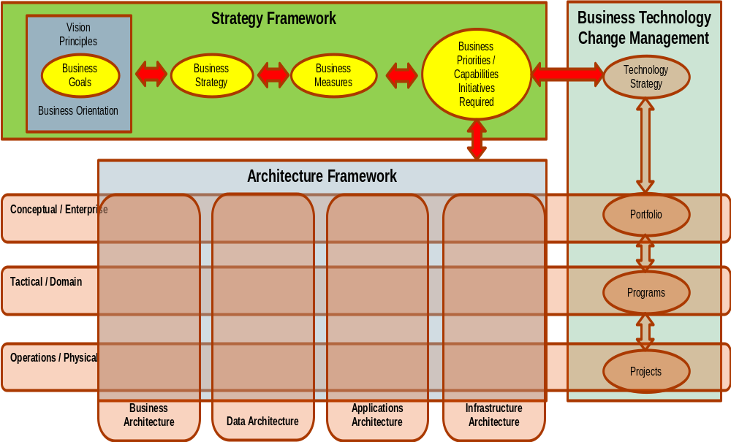
What is Line of Sight? – How it all hangs together
Combination of a Strategy Framework, Technology Change Management responses and Architecture Framework enable “Line of Sight” models and business value to be created
Products and
Services
Key Messages
Go to Market
Channels – Electronic and Face to Face
Customer Segments

Slide 7
Why Line of Sight?
Aligning your Business Strategy with Execution Strength
Generate insight that adds value to your business and technology decision makers on the current state and organisation direction
Enable clear trade off decisions to be made and governed on the journey i.e Strategic Choices, Timing, Funding, Sponsorship and messages
Enabling alignment within business units and alignment between business and technology functions and customer expectations i.e delivery expectations
Similar / consistent language and visual representations creates strong organisational DNA, greater efficiencies and user / stakeholder buy in i.e fast track scoping, impact assessments and user uptake
Directly impact on key organisational metrics such as Customer Satisfaction, Customer Retention, Acquisition and Cross Sell, Revenue, Cost, Risk and Compliance
Find your sweet spots and repeatable patterns that enables focus on execution of your Business Strategy

Slide 8
Business and Technology Strategy alignment
Strategy Assumptions
Business and Technology Strategy vis Performance
Simplify your Business - Case Studies – solving business and technology problems
  Small Business
  HealthCare Group
  Mining Group
  Financial Services Group
  Transport Services
Architecture Method and Solution Approach

Slide 9
Start with WHY? – What is your value proposition and why does it create value?
Behaviour: The measurable response of an enterprise to its environment.
What is the Value Proposition for your business or technology solution?
Corporate Examples: Sony
Johnson & Johnson
Vistakon (Acuvue Lenses)
Product Leadership
From product differentiation to product leadership
Business
Behaviour
From operational competence to operational excellence
From customer responsive to customer intimacy
Operational Excellence
Customer Intimacy
Corporate Examples: McDonalds
Dell Computer
GE Applications
Corporate Examples: Home Depot
Cable & Wireless
IBM
The Value Disciplines of Market Leaders
Treacy & Wiersema

Slide 10
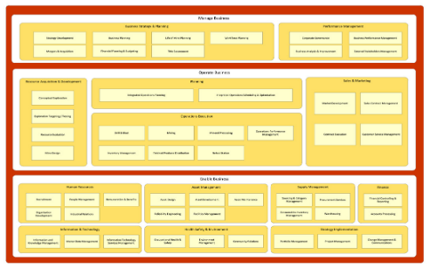
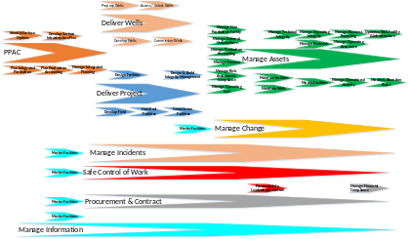
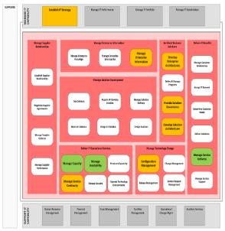
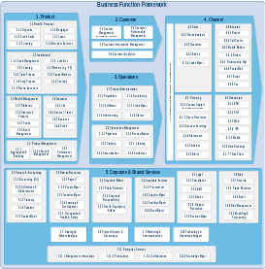
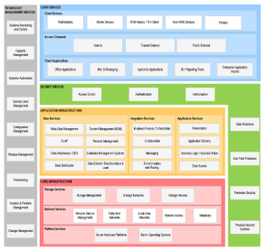
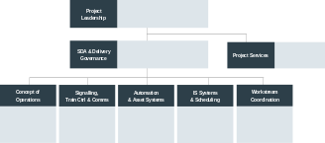
Build Visibility - Architecture Models can simplify and align your Customer, Business and Technology responses
Conceptual / Strategic / Whole of Business
Business Capability model provides a script and a language for interpreting business and technology priorities and approach to achieving your business strategy. It also enables a consistent communication of priorities and trade offs
Business Process Models - High level Function / Process models that deliver value to your customers
Organisation Chart for Business and Technology Divisions - High level Function / People / FTE / Cost assessment
Information Technology Reference Model - High level IT Function / Capability assessment
Application Reference Model - High level Application platform assessment
Infrastructure Reference Model - High level Infrastructure assessment
**A wide range of data can be modelled including RAG ratings, specific insights, FTE’s, costs, and risks. Model use is primarily as a holistic overview to drive out patterns, areas of interest or capabilities that may need more detailed investigation.

Slide 11
Simplify your Business example - how to optimise your business operating model
SHAREHOLDERS AND REGULATORS
Go to Market
OUTBOUND
INBOUND
Enterprise
S
U
P
P
L
I
E
R
S
C
U
S
T
O
M
E
R
S
OUTBOUND
INBOUND
Function
Function
Function
Business
Outcome
INBOUND
OUTBOUND
OUTCOME
MEASURES
WHAT?
Business Outcomes are the result of co-operation between front and back office functions / capabilities.
Gaps identified against current delivery
An optimally arranged Business Architecture can uncover strategic opportunities for change.
INBOUND
OUTBOUND
WHY?
Gaps identified against current delivery to focus adjustments, initiatives, funding
An optimally arranged Business Architecture can uncover strategic opportunities to optimise your business.
BUSINESS SUPPORT

Slide 12
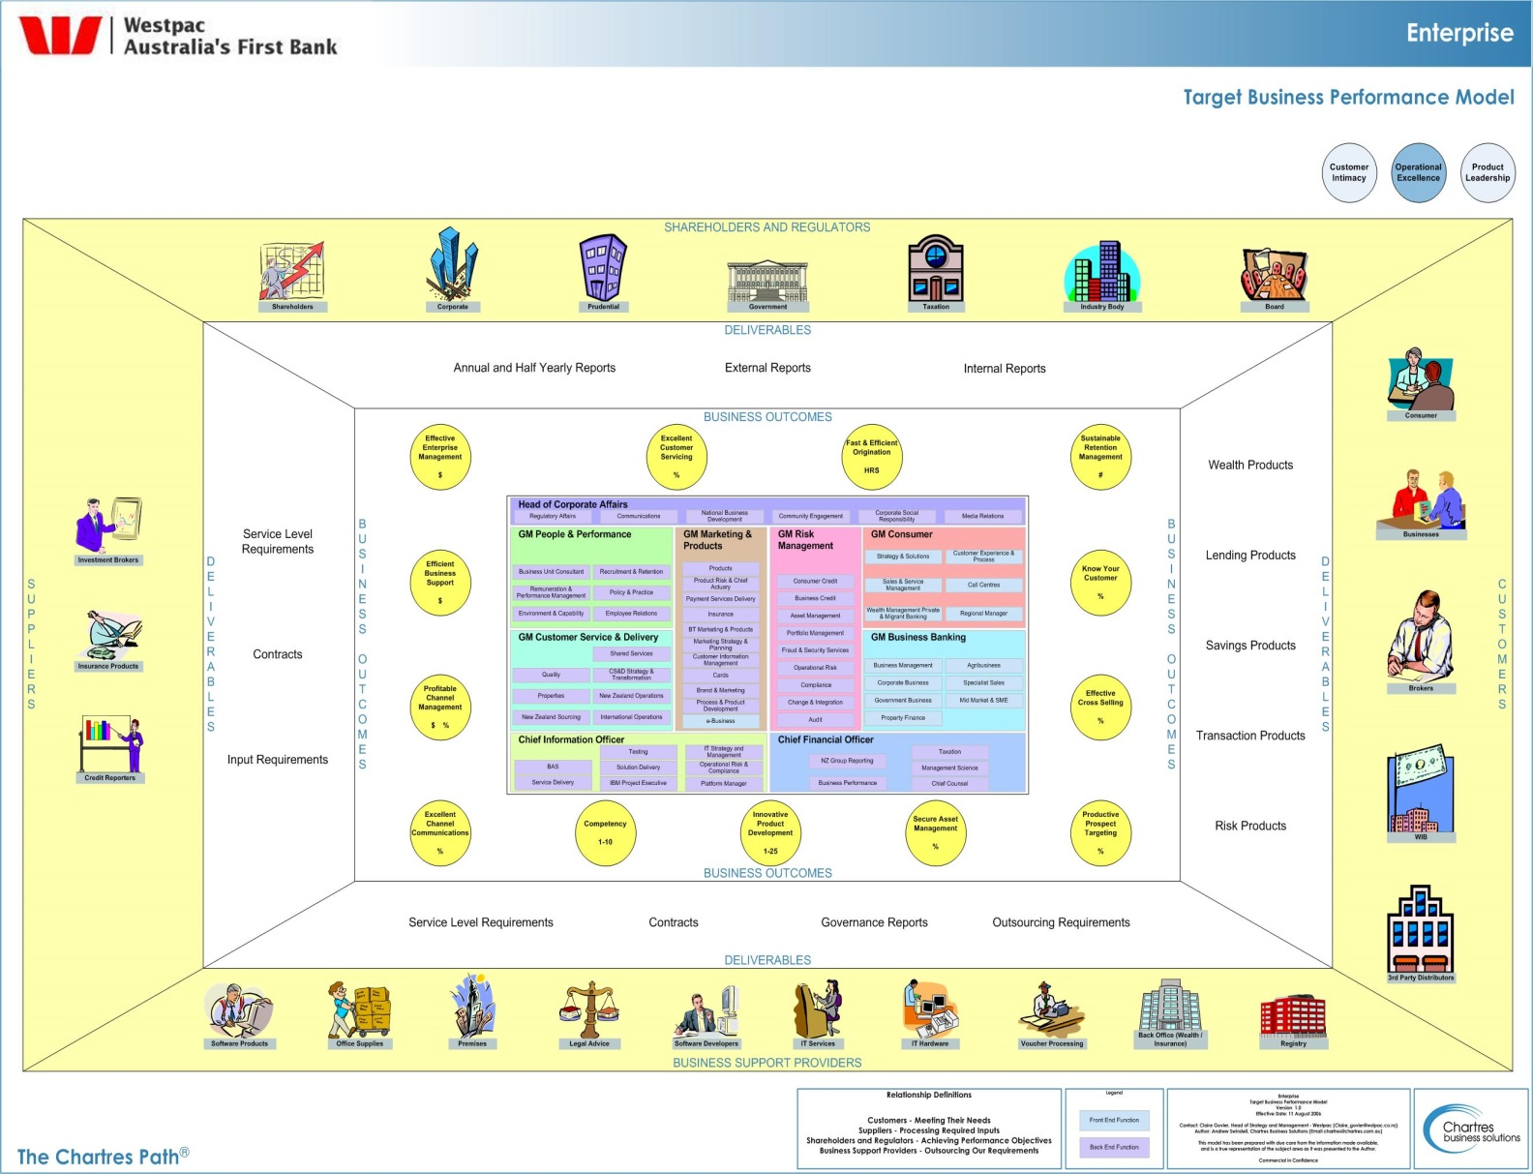
Simplify your Business example – Business Model creates insights to align resources and investments with outcomes
Multiple channel owners impact organizational agility, technology not “fit for purpose”
Multiple Product development portfolios impact customers with focus not on the highest value
Highlight the complexity of the product development lifecycle, the marketing and communication channels and lack of focus and ownership of the customer
Simplify the organisational structure and accountabilities to streamline deployments

Slide 13
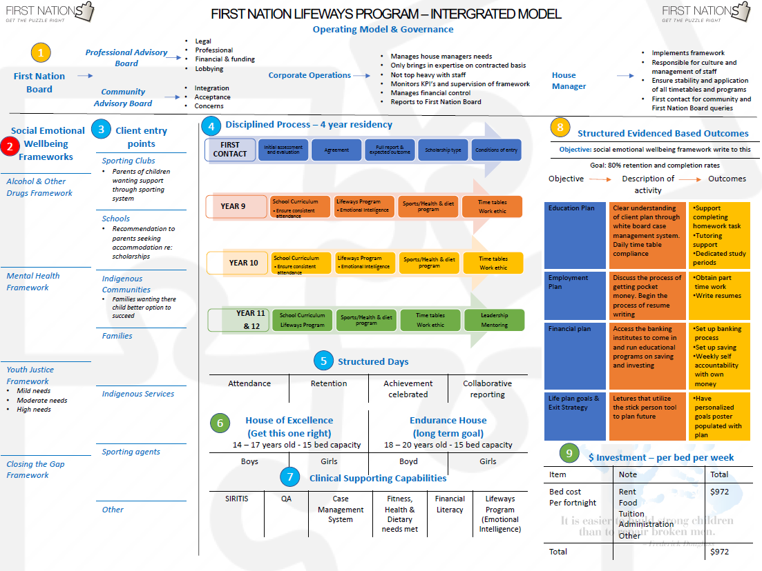
Simplify your Business example – Put your Business Model and Strategy on a Page to simplify messages

Slide 14
Simplify your Business example – Services to Products – 30+ Services simplified to 6
Meeting Reschedules
Email auto responder writing and setup
Meeting Invitations
Book Keeping
Warm calls to existing clients / customers
Manage Electronic Communications
Collect and Record Meeting RSVP’s / Outcomes
Manage Meeting Outcomes / Events
Stationary and Inventory Control
Optimise Business
Courtesy follow up calls
Agenda Preparation and Distribution
Workflow refinement and documentation
Voiceovers for video or promotional material
Diary Management
System Creation and Maintenance
Customer Satisfaction Surveys
Attendee Management
Model your Business
Phone or SMS Appointment confirmations
Book Flights
Convert or complete training documentation
Book Transfers
Data Entry and Vetting
Manage Documents
Transcribe electronic meeting minutes
Prepare Materials
Book Hire Cars
Booking Service
Organising Digital Files
Create Powerpoint Presentations
Book Accommodation
Client appointment preparation
Prepare Handouts / Worksheets
Book Restaurants
Staff training and employee manuals
Book Conference Tickets
Take a long shopping list of services and convert to 6 core products that solve customer problems and simplify your messages
Source Venues and Suppliers for Meetings / Events

Slide 15
Simplify your Business example - Go to Market – Monetise your Business through right messages, channels & customers
Products / Services
Channels
Messages / Experiences
Customer Segments
Manage Meeting Outcomes / Events
P - Face to Face
Small Business
(Operating less than 12mths)
Carpenters, Plumbers, Electricans
Service Business Partner
Prepare Materials
P – Business Demonstrations
Service Based Businesses
What are the messages of love and loyalty from my customer base that can be leveraged with other customers?
Simplify the marketing choices and effort
Make your business run smoothly
Manage Documents
E - Website
Business Owner
(No Staff)
E - Email
Administrative and Customer Care Support
Manage Electronic Communications
E – Posts / Articles
Business Owner
(Several Staff)
Let you get on with running your business
Booking Service
E – SMS
E – Phone Calls
Improve and Optimise your business
Accountants / Industry Assoc
Optimise Business
E – Google Hangouts
Quality Service, Accuracy, Efficiency, Loyalty and Satisfaction, Less time with Admin and more time on Business Value

Slide 16
Simplify your Business example - Go to Market – Package your Products based on your marketing messages
Products / Services
Channels
Messages / Experiences
Customer Segments
Beauty Devices
P - Face to Face
Fall in Love
Slow Ageing Process (40+)
P – Group Demonstrations
Users of Product
Which customers are buying which products and which messages through which channels are having the greatest impact and success in generating sales
Simplify the funding and investment decisions
Biophotonic Scanner
P - Training
Seeing Results
P – Pamper Party
Prevent Signs of Ageing (20-40)
Share Experiences
Health Products
E - Facebook
Share Products
E – Public Personal Page
Use in Bathroom
Supplementary Income Stream
SkinCare
E – Closed Group Page
E - Web Page
Use in Supplements Cabinet
Freedom
Connection / Collaboration
Frustrated

Slide 17

Simplify your Business example - Business Processes aligned to scale your business
Do you know what processes deliver value to your customers?
What processes are supported and in scope for your technology solution?
Is your team aligned to your Ways of Working?
Where are the patterns and sweet spots in your business?
Where are the pain points and manual processes that fall over?
Simplify the strategic choices to improve business processes

Slide 18
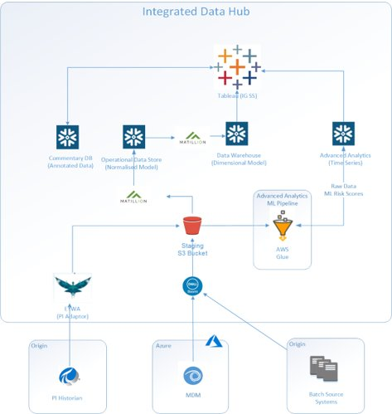
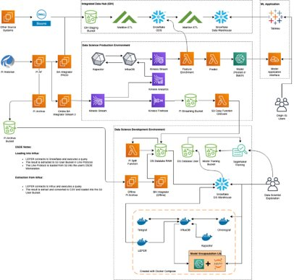
Simplify your Business example – Technology ecosystem delivering significant business outcomes
Developed an Advanced Analytics pipeline for executing Machine Learning models. The solution used AWS Glue to execute Spark ML jobs for both ETL and model execution.​
The AA pipeline leveraged the Integrated Data Hub Architecture which uses Snowflake as a data warehouse.
Outcomes generated include uplift in gas production, quicker mean time to return for wells offline and a number of process insights to improve gas quality and output
Simplify the communication of how technologies come together to create solutions that work.

Slide 19
Business and Technology Strategy alignment
Strategy Assumptions
Business and Technology Strategy vis Performance
Simplify your Business - Case Studies – solving business and technology problems
  Small business
  HealthCare Group
  Mining Group
  Financial Services Group
  Transport Services
Architecture Method and Solution Approach

Slide 20
Method - Line of Sight Approach
It’s all about the Data
Ensure your data is in a mature state, agreed and available to support your architecture mapping. Data that can be mapped includes:
  Customer Segments – who will generate value for you
  Products and Services, Customer Messages, Distribution Channels
  Business Strategies – including Channel, Products and Marketing messages
  Measures / Outcomes – SMART (Specific, Measurable, Attainable, Relevant, Timely)
  Business Capabilities – Business Capability Model
  Information, Applications and Technology Infrastructure Assets / Model
  Projects – list of all projects and initiatives including $$$, focus, timing
  Business Units – Organisational Chart outlining key functions
  Stakeholders – Influencers, Operational Budgets and FTE, Risks and Dependencies

Slide 21

Biography
25+ year career with Line Management roles in Sales & Marketing and deep Consulting, Architecture experience.
Last 15 years as an Enterprise Architect building Architecture Practices , enabling business and technology strategies and solving complex business challenges.
Business and Technology delivery success across 30+ companies primarily in Banking, Mining, Utilities, Transport and Health industries
Domain expertise in Business, Applications, Integration and Information Architecture and deep experience in BI and CRM.
Top down whole of company, whole of country focus applying Enterprise and Solution Architecture disciplines to simplify your decision choices.
Experience across Australia and New Zealand, author of Architecture white papers, eBooks, articles and member of Motivational Speakers Australia
Recently Enterprise Business Information Architect at NSW Transport, supporting multi Agency $20bn+ portfolio of projects and now optimising the Gas Supply Chain for Origin Energy

